Slide 1
‘X’ Sex:
Epic Registration Update
August 24, 2024

Slide 2

‘X’ Sex Marker in Epic
What To Expect?
The option “X” will be added for selection in the Legal Sex and Sex Assigned at Birth fields in Epic beginning December 15, 2023.

Slide 3
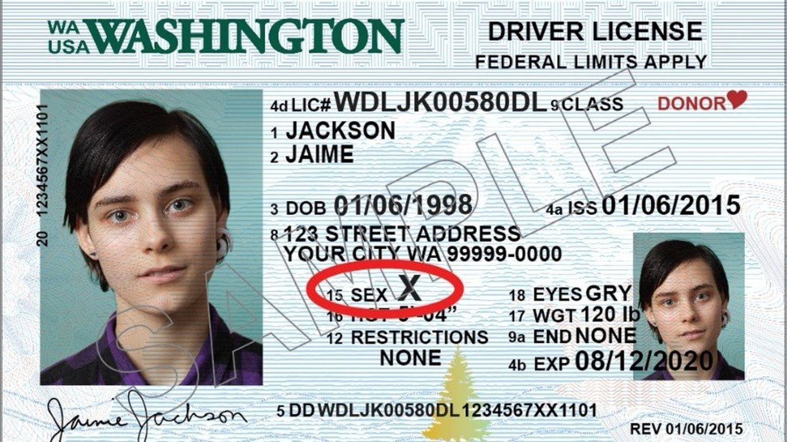
‘X’ Sex Marker in Epic
What To Expect?
X is a response option on government identification documents (such as driver’s licenses, passports and birth certificates) that designates a legal sex other than male or female. Most commonly, people who are intersex, transgender or nonbinary may opt to use X on their identification papers.

Slide 4
Why is NM adding X to Epic?
Supporting our Patient’s First mission
Northwestern Medicine is adding X to these fields to better support the health and patient care of nonbinary, intersex and transgender patients.
  Having accurate and consistent information about our patients’ legal sex and sex assigned at birth helps us to address patients’ anatomical health needs, send out correct health reminders, and coordinate appropriate and responsive care focused on each patient’s specific needs.
  It also allows us to better understand the populations we are serving.
By adding X to Epic, we are acting in alignment with the state of Illinois, which has recently included X as an option for birth certificates and will soon include X on state IDs and driver's licenses.

Slide 5
Updates to Legal Sex and Sex Assigned at Birth Fields
Current Legal Sex Categories | Updated Legal Sex Categories Coming January 1
Male Female Unknown | Male Female X Unknown
Current Sex Assigned at Birth Categories | Updated Sex Assigned at Birth Categories Coming January 1
Choose not to disclose Female Male Not recorded on birth certificate Uncertain Unknown | Choose not to disclose Female Male X Not recorded on birth certificate Uncertain Unknown
Content Header 17 Calibri Regular
Content Header

Slide 6
X and Patient Registration
Supporting our Patient’s First mission
Registrars can select X as their Legal Sex for patients who have X listed as their sex on their state or government IDs.
Registrars can select X as their Sex Assigned at Birth for patients who have X listed as their sex on their birth certificate.
These fields should only be changed if a patient has X or Nonbinary listed on these official records.
For all patients, but particularly for those who have chosen X as a designation on their identification documents, it is best practice to confirm personal pronouns and preferred name.

Slide 7
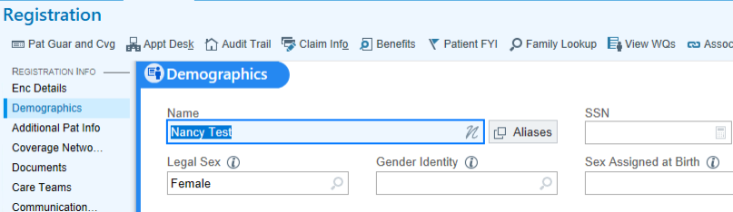
Entering X in Legal Sex
Legal sex is the sex (male, female or X) recorded on an individual’s state or government identification documents.
A patient’s legal sex should match the sex listed on their state or government ID.
Registrars should enter the sex indicated on a patient’s identification document(s) into the “Legal Sex” field in Demographics.
Ask one of these questions:
  What is your legal sex?
  What sex is listed on your driver's license, State ID, passport?

Slide 8
Entering X in Sex Assigned at Birth
Patients may request to have their sex assigned at birth updated during registration.
Registrars may update this information in the “Sex Assigned at Birth” field.
Ask this question:
  What sex were you assigned at birth that is on your birth certificate?

Slide 9
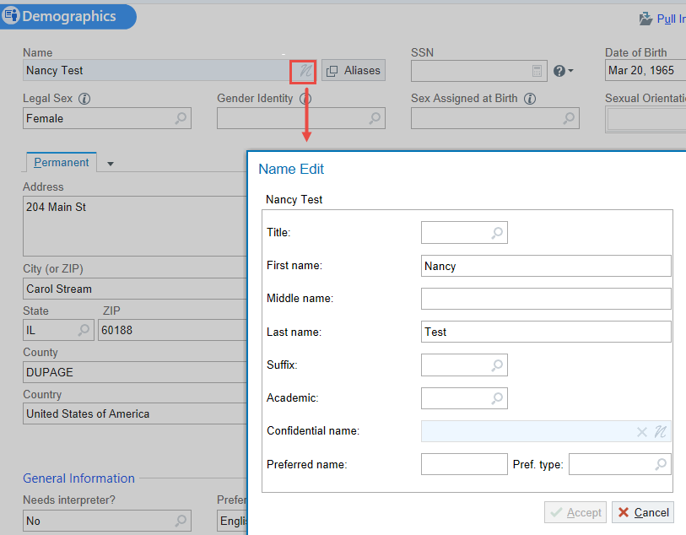
Entering Preferred Name
Preferred name can be entered in the “Name Edit” window.
To access this window, click the icon in Demographics
Enter the patient's preferred name in the preferred name field.
Ask one of these questions:
  What name do you go by?
  What name would you like our staff to use when addressing you?
  Is there another name you like to be called other than your legal name?

Slide 10
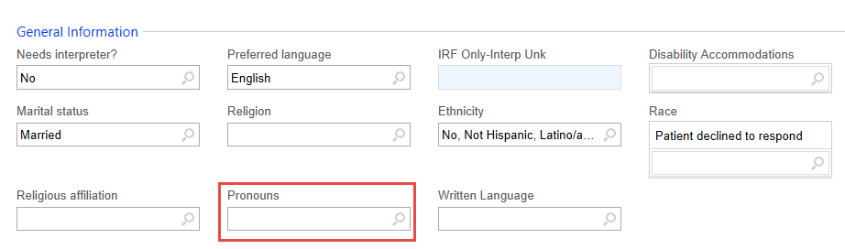
Entering Pronouns
Pronouns can be entered in the “General Information” section under Demographics.
Ask one of these questions:
  What pronouns do you use?
  Would you like to designate your personal pronouns?
  My name is [Maria] and I use [she/her] pronouns. May I ask which pronouns you use?

Slide 11
Responding to Patients Concerned
Patient Concern
Response
"Why are you collecting this information?"
“We want to make sure that we are able to identify and address all of our patient’s needs. It’s part of ensuring that all of our patients receive the highest quality of care.”

Slide 12
Responding to Patients Concerned
Patient Concern
Response
"Who will see this information?"
“This information is confidential. The only people to see this information will be members of your care team and those who are authorized to see your medical record.”

Slide 13
Responding to Patients Concerned
Patient Concern
Response
"Why are you asking for my preferred name or pronouns?"
“We want to be sure we correctly address all of our patients. Asking this information of everyone helps us get it right.”

Slide 14
Responding to Patients Concerned
Patient Concern
Response
"I'm obviously a [man/woman], why are you even asking me this?"
“These are questions we ask every patient. We want to make sure our records are correct. Let’s move on to make sure the other information we have on file for you is right.”

Slide 15
Responding to Patients Concerned
Patient Concern
Response
"You used the wrong pronoun for me."
"I’m sorry. Could you please remind me what pronouns you use?"

Slide 16
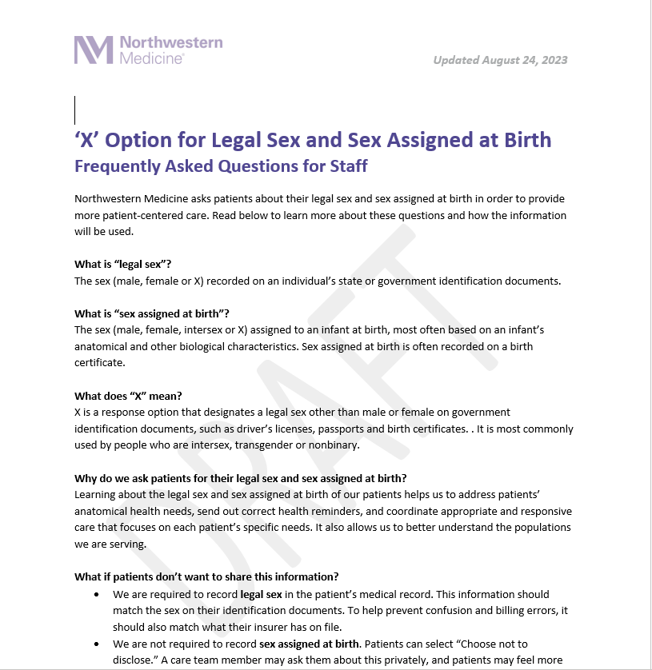
FAQ Resources
FAQ sheets covering X, Pronouns and Preferred Name will be provided for both patients and staff on NM Interactive.
Information for patients will also be added to nm.org.

Slide 17
Questions?

Slide 18
Thank You

